Slide 1
DPE ROBOTICS TEAM
HOW THE ROBOT WORKS

Slide 2
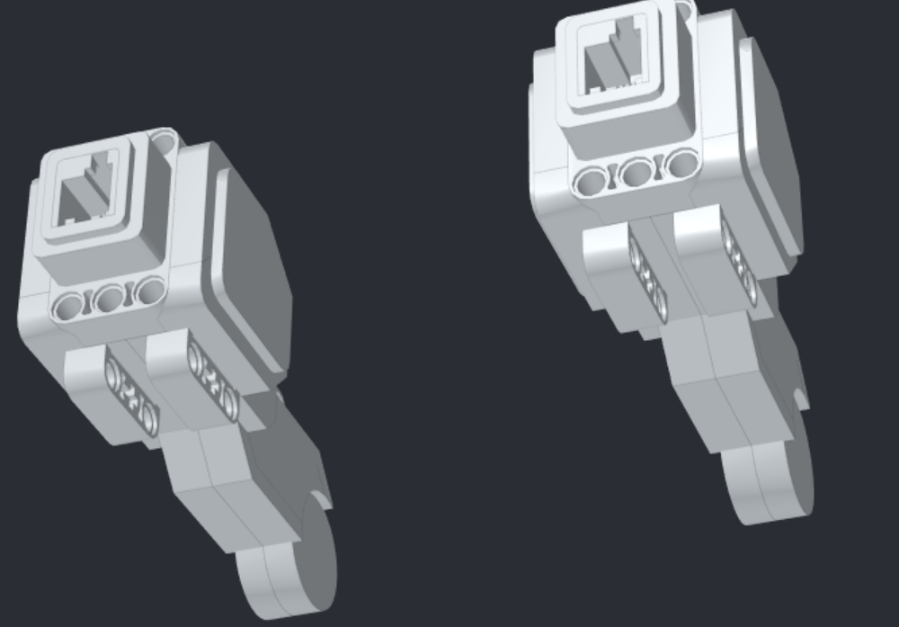
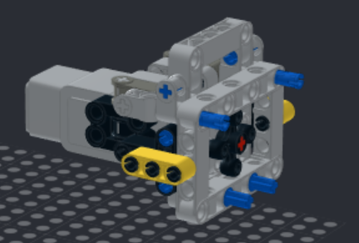
THE MOTORS WE USE
We have 4 motors, 2 we use for moving the robot by each of the wheels. And the other 2 we have for moving the arm. One of the motors, (that is used for the arm) is responsible for moving the elbow, and the other is responsible for moving the shoulder.

Slide 3

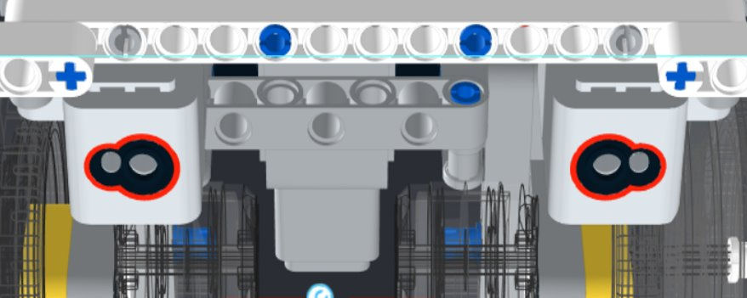
WHAT THE SENSORS ARE USED FOR
We have 2 light sensors, and 1 gyro sensor, the gyro sensor is use for turning, but as it is not very precise we do not use it. The 2 light sensors we actually use, as we can use it for navigating the map, as we can follow the black lines.
Light Sensors
The light sensor is used to track lines, but it has its flaws, sometimes the light sensor would get mixed up between Dark Blue and Black.

Slide 4
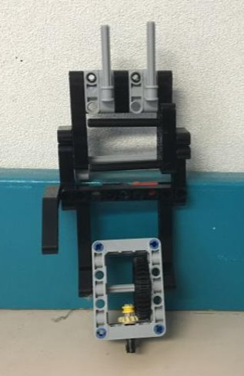
THE ARM
The arm, the arm as shown by the video is perhaps the most important part of the robot as it completes most if not all of the missions. The reason that we chose this model for the arm is because of the wing, the ability to not only use the arm, but to also have the ability to also use it for the mission itself is amazing. Scoring extra points while using it to get more points.

Slide 5
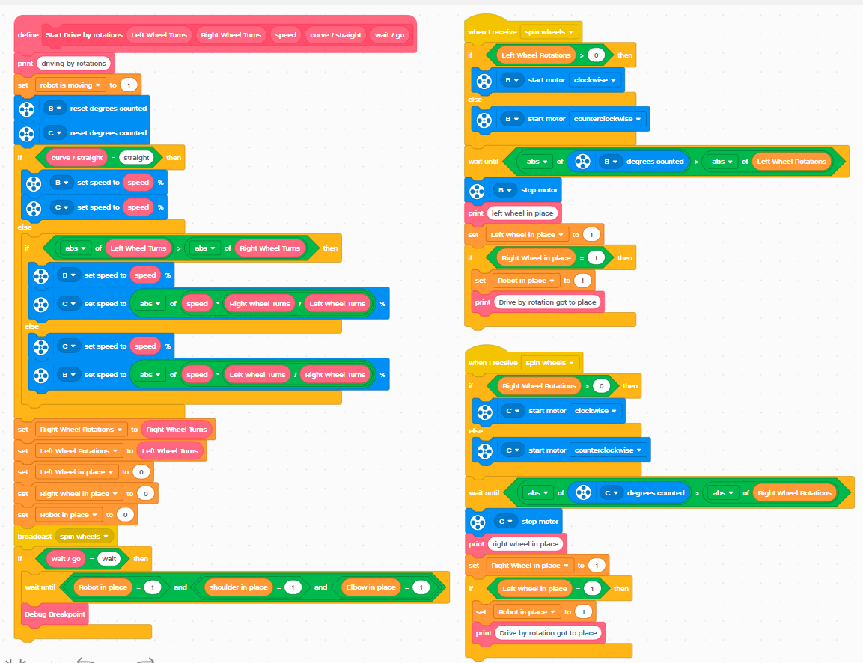
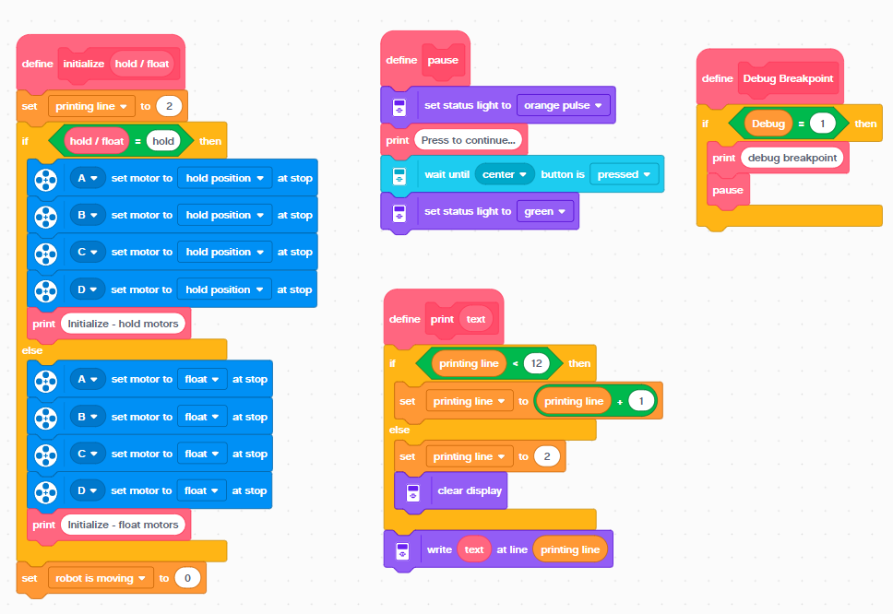
Our Code

Slide 6
HOW THE ROBOT CAME TO BE
The base of the robot was designed by a team in Tel-Aviv which is called D-bug, from robot a called educator++. But we keep improving different aspects of robot. The arm is one such example, the arm of the robot was too heavy, and was always unbalanced. So we decided to add some counter weight to the robot, two giant wheels. These wheels also presented improvements themselves, the wheels were big and sturdy enough so that they could complete missions themselves, like rotating to hit the latch for the helicopter mission.

Slide 7
PROBLEMS WE ENCONTERED
One of the problems that we had was what the arm was to heavy so we had to add some counter weights.
We already mentioned this, but another issue was that the light sensors were too inaccurate sometimes with the readings. It would sometimes confuse Dark Blue with Black.
We also discovered that the gyro, would drift over time, e.g. after 5 minutes the gyro would increase by 5 when we didn't even move the gyro.

Slide 8

PROS AND CONS OF USING THIS ROBOT
CONS
PROS
xt
1. It can sometimes break
2. It takes some space
3. Arm is a little heavy
1. You can use the arm for a lot of missions
2. Robot is balanced
3.we can use the back for mission
4.Easy fix when falls apart

Slide 9
Thank you for watching

